Slide 1



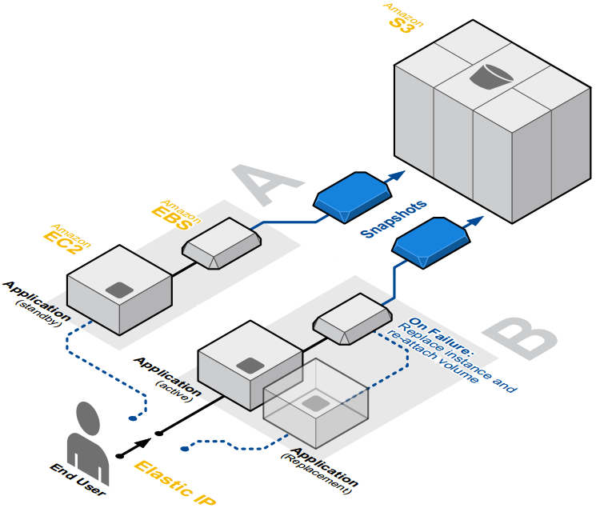
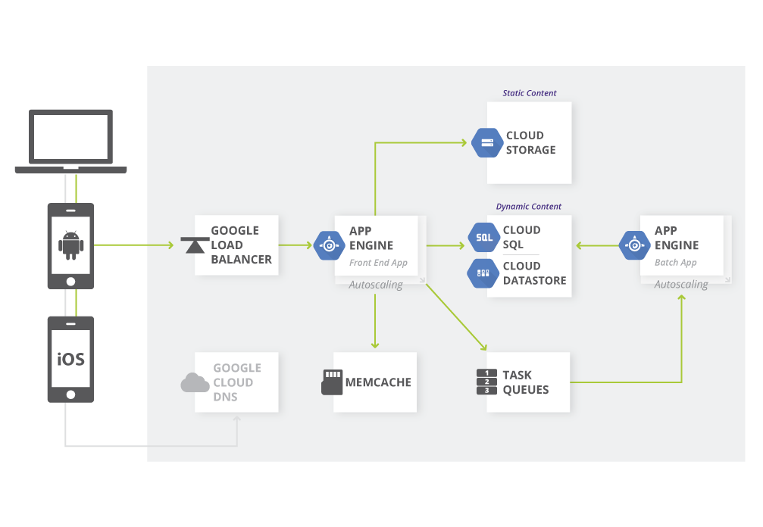
Fault-Tolerant Cloud Computing Architectures A comparative study
Authors: Andreas Kjeldsen (s092638), Morten Eskesen (s133334)
Architecture
Example of fault-tolerant application architecture hosted on AWS
Google Web Application Architecture on Google App Engine
Tekst her
Tekst her
Redundant storage
Tekst her
Tekst her
Availability
Tekst her
Tekst her
Load balancing
Tekst her
Tekst her
DTU Compute
DTU Compute
Notes:
Tekst og Streger i 100% farve – Baggrund i 90% Transparent.

Slide 2
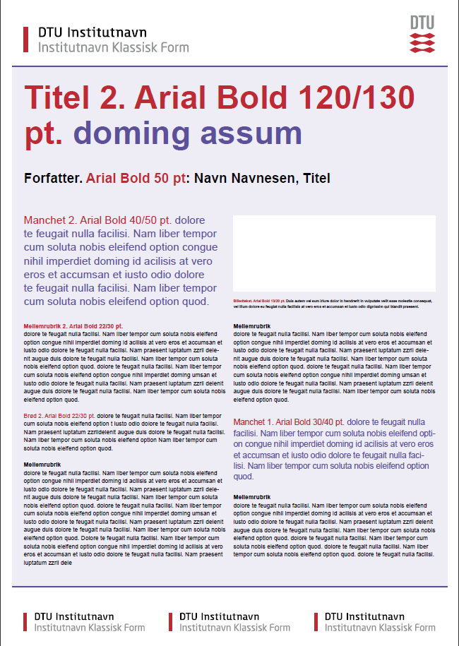

Titel Arial Bold 1. 90/110pt, 2. 120/130pt, 3. 145/155pt. )
Forfatter: Navn, Titel (Arial Bold 50pt)
Manchet (Arial Bold 1. 30/40pt. el.
2. 40/50pt)
Mellemrubrik (Arial Bold 1. 18/24pt. el. 2. 22/30pt.)
Brødtekst (Arial 1. 18/24pt. el. 2. 22/30pt.)
Indsæt billede<
Billedtekst (Arial Regular 13/20Pt.)
Mellemrubrik (Arial Bold 1. 18/24pt. el. 2. 22/30pt.)
Brødtekst (Arial 1. 18/24pt. el. 2. 22/30pt.)
Manchet (Arial Bold 1. 30/40pt. el.
2. 40/50pt)
Mellemrubrik (Arial Bold 1. 18/24pt. el. 2. 22/30pt.)
Brødtekst (Arial 1. 18/24pt. el. 2. 22/30pt.)

Slide 3
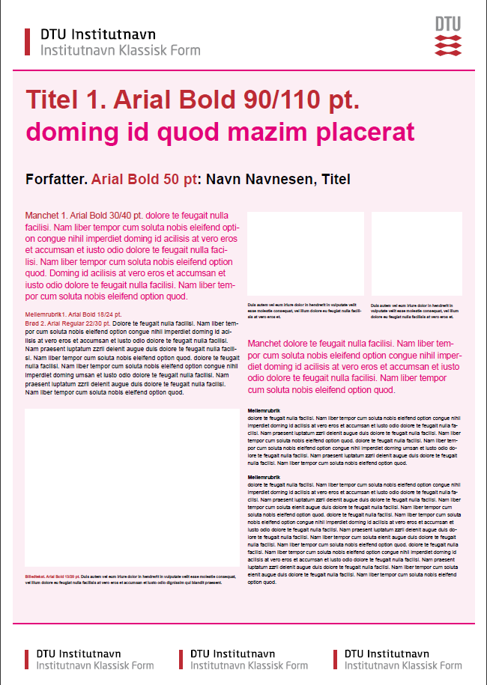
Titel Arial Bold 1. 90/110pt, 2. 120/130pt, 3. 145/155pt. )
Forfatter: Navn, Titel (Arial Bold 50pt)
Manchet (Arial Bold 1. 30/40pt. el.
2. 40/50pt)
Mellemrubrik (Arial Bold 1. 18/24pt. el. 2. 22/30pt.)
Brødtekst (Arial 1. 18/24pt. el. 2. 22/30pt.)
Indsæt billede<
Indsæt billede<
Billedtekst (Arial Regular 13/20Pt.)
Billedtekst (Arial Regular 13/20Pt.)
Manchet (Arial Bold 1. 30/40pt. el.
2. 40/50pt)
Mellemrubrik (Arial Bold 1. 18/24pt. el. 2. 22/30pt.)
Brødtekst (Arial 1. 18/24pt. el. 2. 22/30pt.)
Indsæt billede<
Billedtekst (Arial Regular 13/20Pt.)

Slide 4
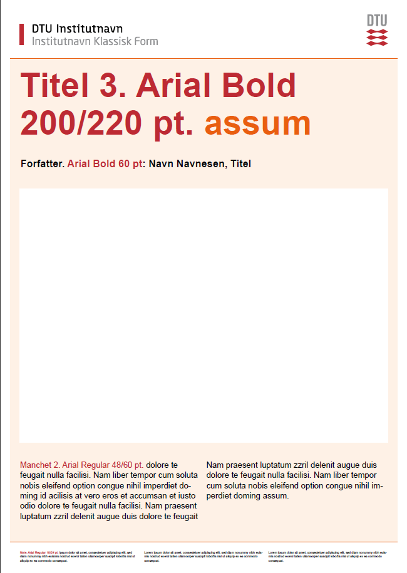
Titel Arial Bold 1. 90/110pt, 2. 120/130pt, 3. 145/155pt. )
Forfatter: Navn, Titel (Arial Bold 50pt)
Indsæt billede
Manchet (Arial Bold 1. 35/45pt. el. 2. 48/60pt)
Manchet (Arial Bold 1. 35/45pt. el. 2. 48/60pt)
Note eller Institutnavn (Arial Regular 14/18pt.)
Note eller Institutnavn (Arial Regular 14/18pt.)

